Slide 1
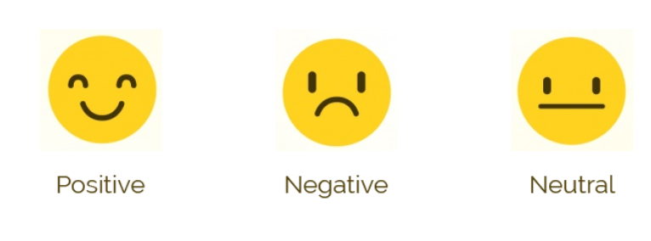
Sentiment Analysis
To Classify TWEETS as Positive or Negative

Slide 2
INTRODUCTION
Extracting The Data set –Tweepy
Tweets with Hastags
#NoWarInUkraine,#RussianUkrainianWar,#Ukraine,#Russia
Preprocessing
Tokenization, Removing Stop Words, Urls, Usernames, Lemmatization, Punctuations, Lower-cases
Training
Testing
Machine Learning Technique- Naives-Bayes Classifier

Slide 3
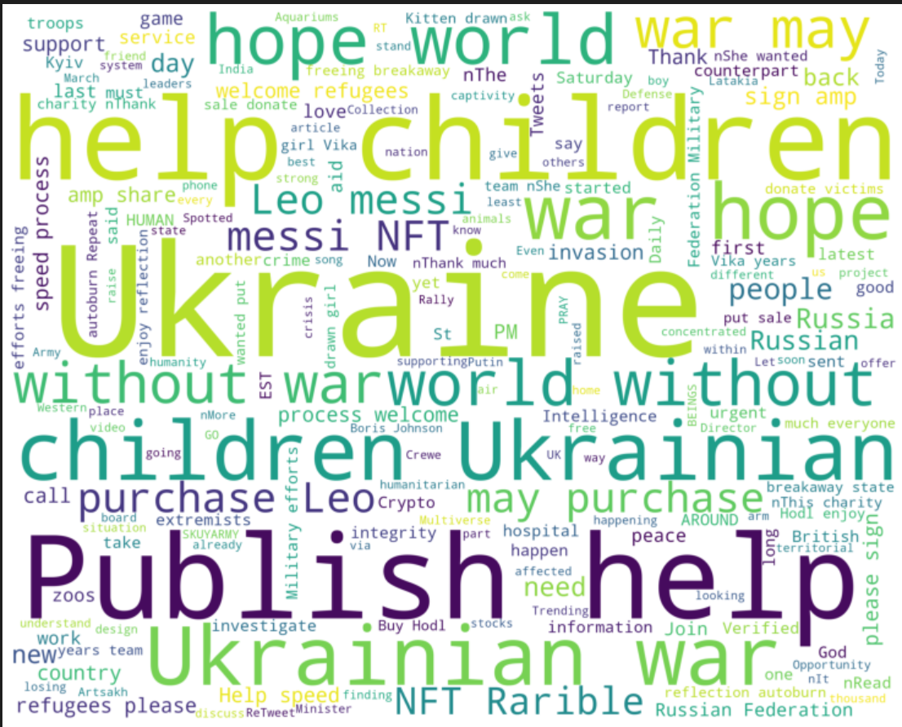
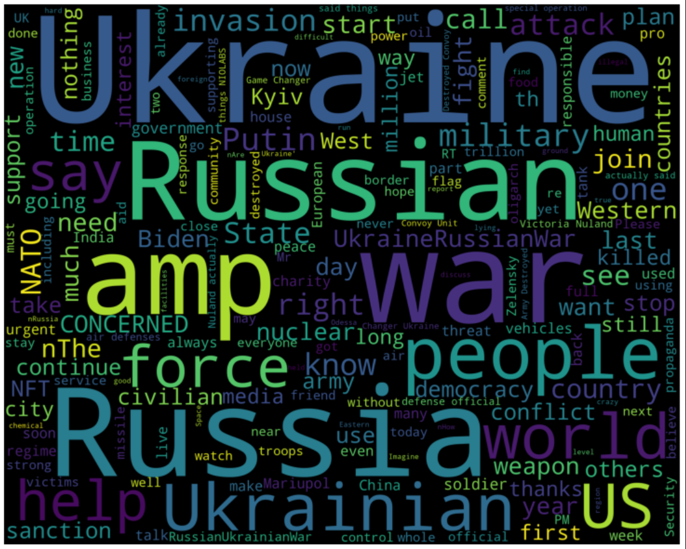
Word Cloud
Positive
Negative

Slide 4

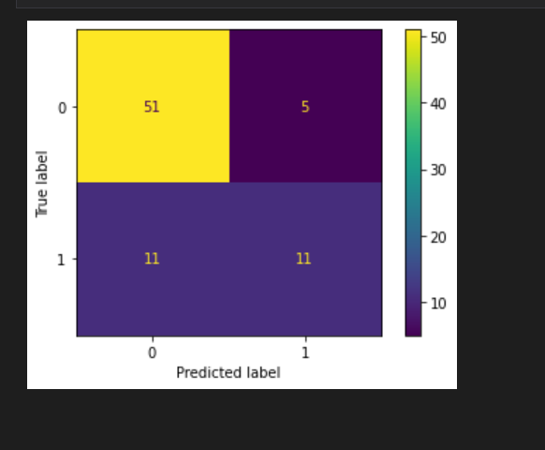
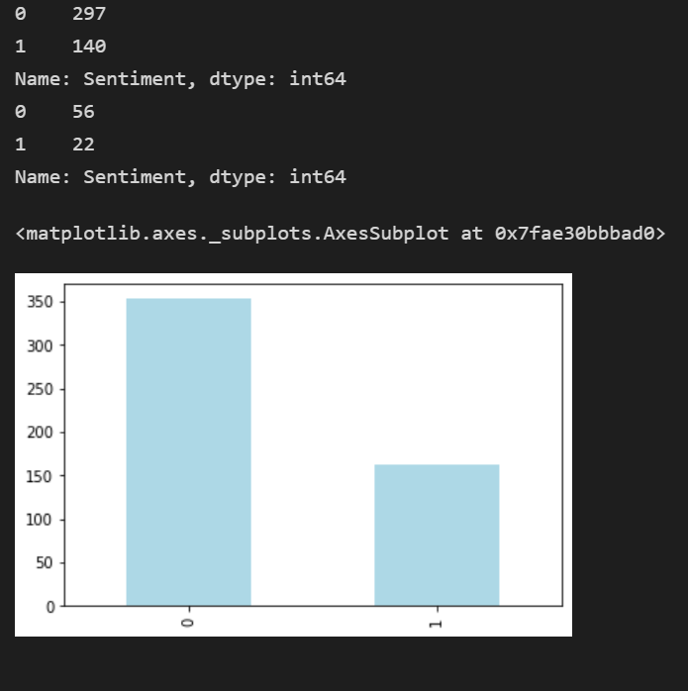
Confusion Matrix

Slide 5
Outcomes
The dataset has been classified into either Positive or Negative but there might be neutral tweets which could be neglected to improve the accuracy of the model.
A different model such as SVM,NLP(SentiWordNet),Decision Tree learning could give different results.
But for Naïve Bayes Classifier, most of the Negative Tweets have been classified unlike the positive tweets.

